Slide 1
Building Beautiful Web Parts
Derek Cash-Peterson

Slide 2




Derek Cash-Peterson
Principal Architect
Professional developer since 1999
Working with SharePoint since 2006
Specialize in branding/ux development
https://spdcp.com
linkedin.com/in/derek-cash-peterson-6320752
@spdcp
https://github.com/dcashpeterson/Public-Samples

Slide 3
Agenda
What is the UI Fabric?
Adding UI Fabric to Web Parts
Responsive Design
Creating a UI Fabric Web Part
How to Use React Components
Q&A

Slide 4
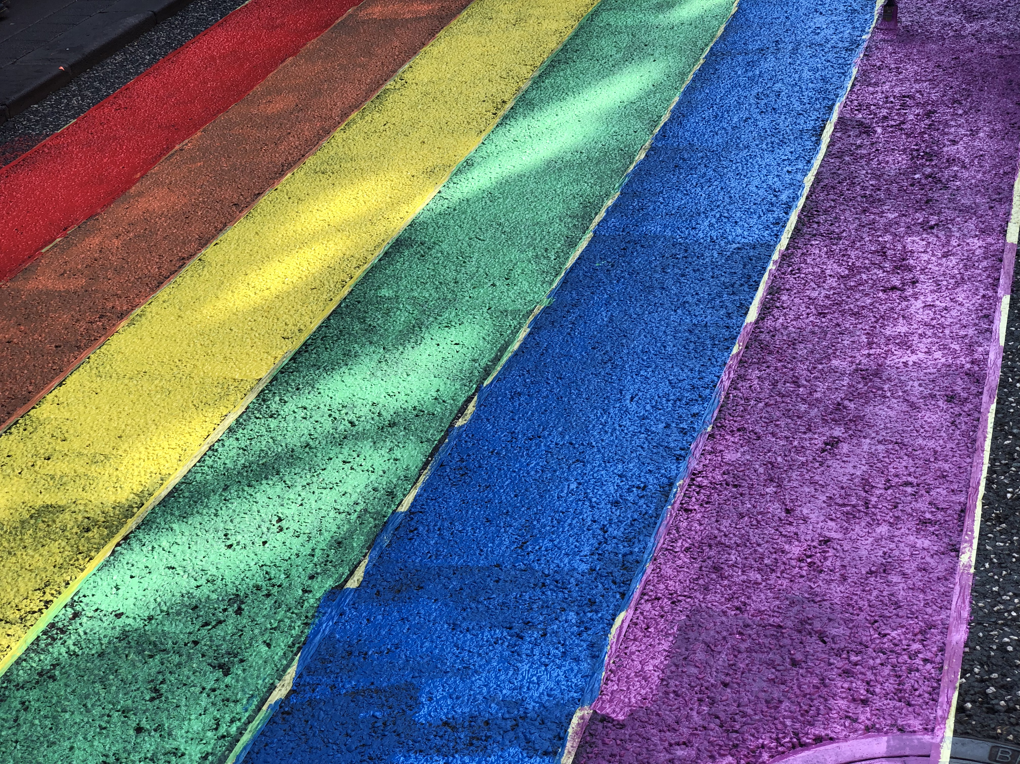
Designers

Slide 5
Designers
Make beautiful things that are not necessarily functional

Slide 6

Developers

Slide 7
Developers
Make functional things that are not beautiful

Slide 8

Design is not just what it looks like and feels like.
Design is how it works.
–Steve Jobs

Slide 9
What Makes a Good User Experience?
Consistent
Readable
Intuitive
These are not a nice to have, it’s our responsibility as developers to our users.

Slide 10
Agenda
What is the UI Fabric?
Adding UI Fabric to Web Parts
Responsive Design
Creating a UI Fabric Web Part
How to Use React Components
Q&A

Slide 11

What is the UI Fabric?

Slide 12
What is the UI Fabric?
Design Language

Slide 13
What is the UI Fabric?
Design Language
Collection of frameworks

Slide 14
What is the UI Fabric?
Design Language
Collection of frameworks
Design tools/guidelines

Slide 15
What is the UI Fabric?
Design Language
Collection of frameworks
Design tools/guidelines
Components

Slide 16
Agenda
What is the UI Fabric?
Adding UI Fabric to Web Parts
Responsive Design
Creating a UI Fabric Web Part
How to Use React Components
Q&A

Slide 17
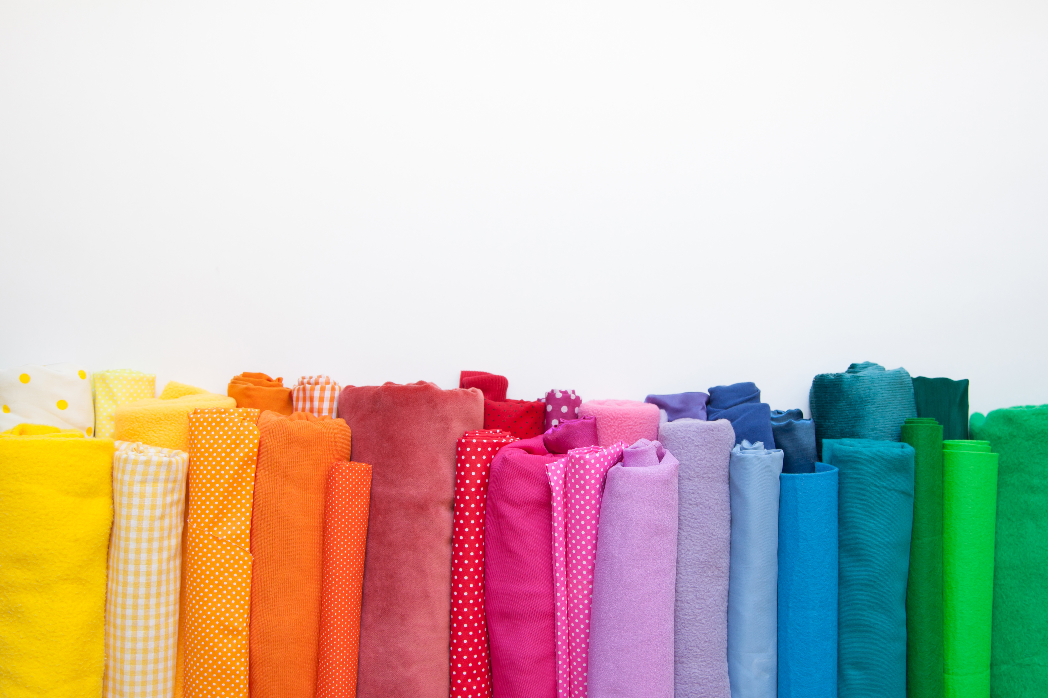
Two Options
Fabric Core
Fabric React

Slide 18
Fabric Core
Open Source
Colors
Fonts, Sizes, Weights
Icons
Transitions
Responsive grid layout framework
Best used for non-React applications

Slide 19
Using Fabric Core
Include reference to CSS file https://static2.sharepointonline.com/files/fabric/office-ui-fabric-core/6.0.0/css/fabric-6.0.0.scoped.css

Slide 20
Using Fabric Core
Include reference to CSS file https://static2.sharepointonline.com/files/fabric/office-ui-fabric-core/6.0.0/css/fabric-6.0.0.scoped.css
Install with NPM @microsoft/sp-office-ui-fabric-core

Slide 21
Using Fabric Core
Include reference to CSS file https://static2.sharepointonline.com/files/fabric/office-ui-fabric-core/6.0.0/css/fabric-6.0.0.scoped.css
Install with NPM @microsoft/sp-office-ui-fabric-core @import '~@microsoft/sp-office-ui-fabric-core/dist/sass/SPFabricCore.scss';

Slide 22
Using Fabric Core
Include reference to CSS file https://static2.sharepointonline.com/files/fabric/office-ui-fabric-core/6.0.0/css/fabric-6.0.0.scoped.css
Install with NPM @microsoft/sp-office-ui-fabric-core @import '~@microsoft/sp-office-ui-fabric-core/dist/sass/SPFabricCore.scss';
Included when you use @Microsoft/sharepoint and don’t choose React

Slide 23
Fabric React
All the benefits of Fabric Core +++
Not the same as Fabric Core
Includes SCSS variables
Includes React Components
Best used for React applications

Slide 24
Using Fabric React
Included when you use @Microsoft/sharepoint and you choose React

Slide 25
Using Fabric React
Included when you use @Microsoft/sharepoint and you choose React
Uninstall UI Fabric Core npm uninstall @microsoft/sp-office-ui-fabric-core --save

Slide 26
A Quick Look
A look at the Fabric Core and Fabric React

Slide 27

Tips and Tricks
Add media queries to change the size of type
Connect your web part to themes
Grid framework doesn’t work great in SharePoint
If you are creating a react app, uninstall the fabric core
Review your bundle

Slide 28
Demo
Review the Bundle

Slide 29
Agenda
What is the UI Fabric?
Adding UI Fabric to Web Parts
Responsive Design
Creating a UI Fabric Web Part
How to Use React Components
Q&A

Slide 30

Quick Chat about
Responsive Design

Slide 31
Quick Chat about
Responsive Design
Using HTML and CSS to resize, hide, shrink, or enlarge components across devices

Slide 32
Quick Chat about
Responsive Design
Using HTML and CSS to resize, hide, shrink, or enlarge components across devices
Mobile First Approach

Slide 33
Quick Chat about
Responsive Design
Using HTML and CSS to resize, hide, shrink, or enlarge components across devices
Mobile First Approach
Think About Transitions

Slide 34
Your Web Part Should Look Great On Every Device and Every Size!

Slide 35
Agenda
What is the UI Fabric?
Adding UI Fabric to Web Parts
Responsive Design
Creating a UI Fabric Web Part
How to Use React Components
Q&A

Slide 36
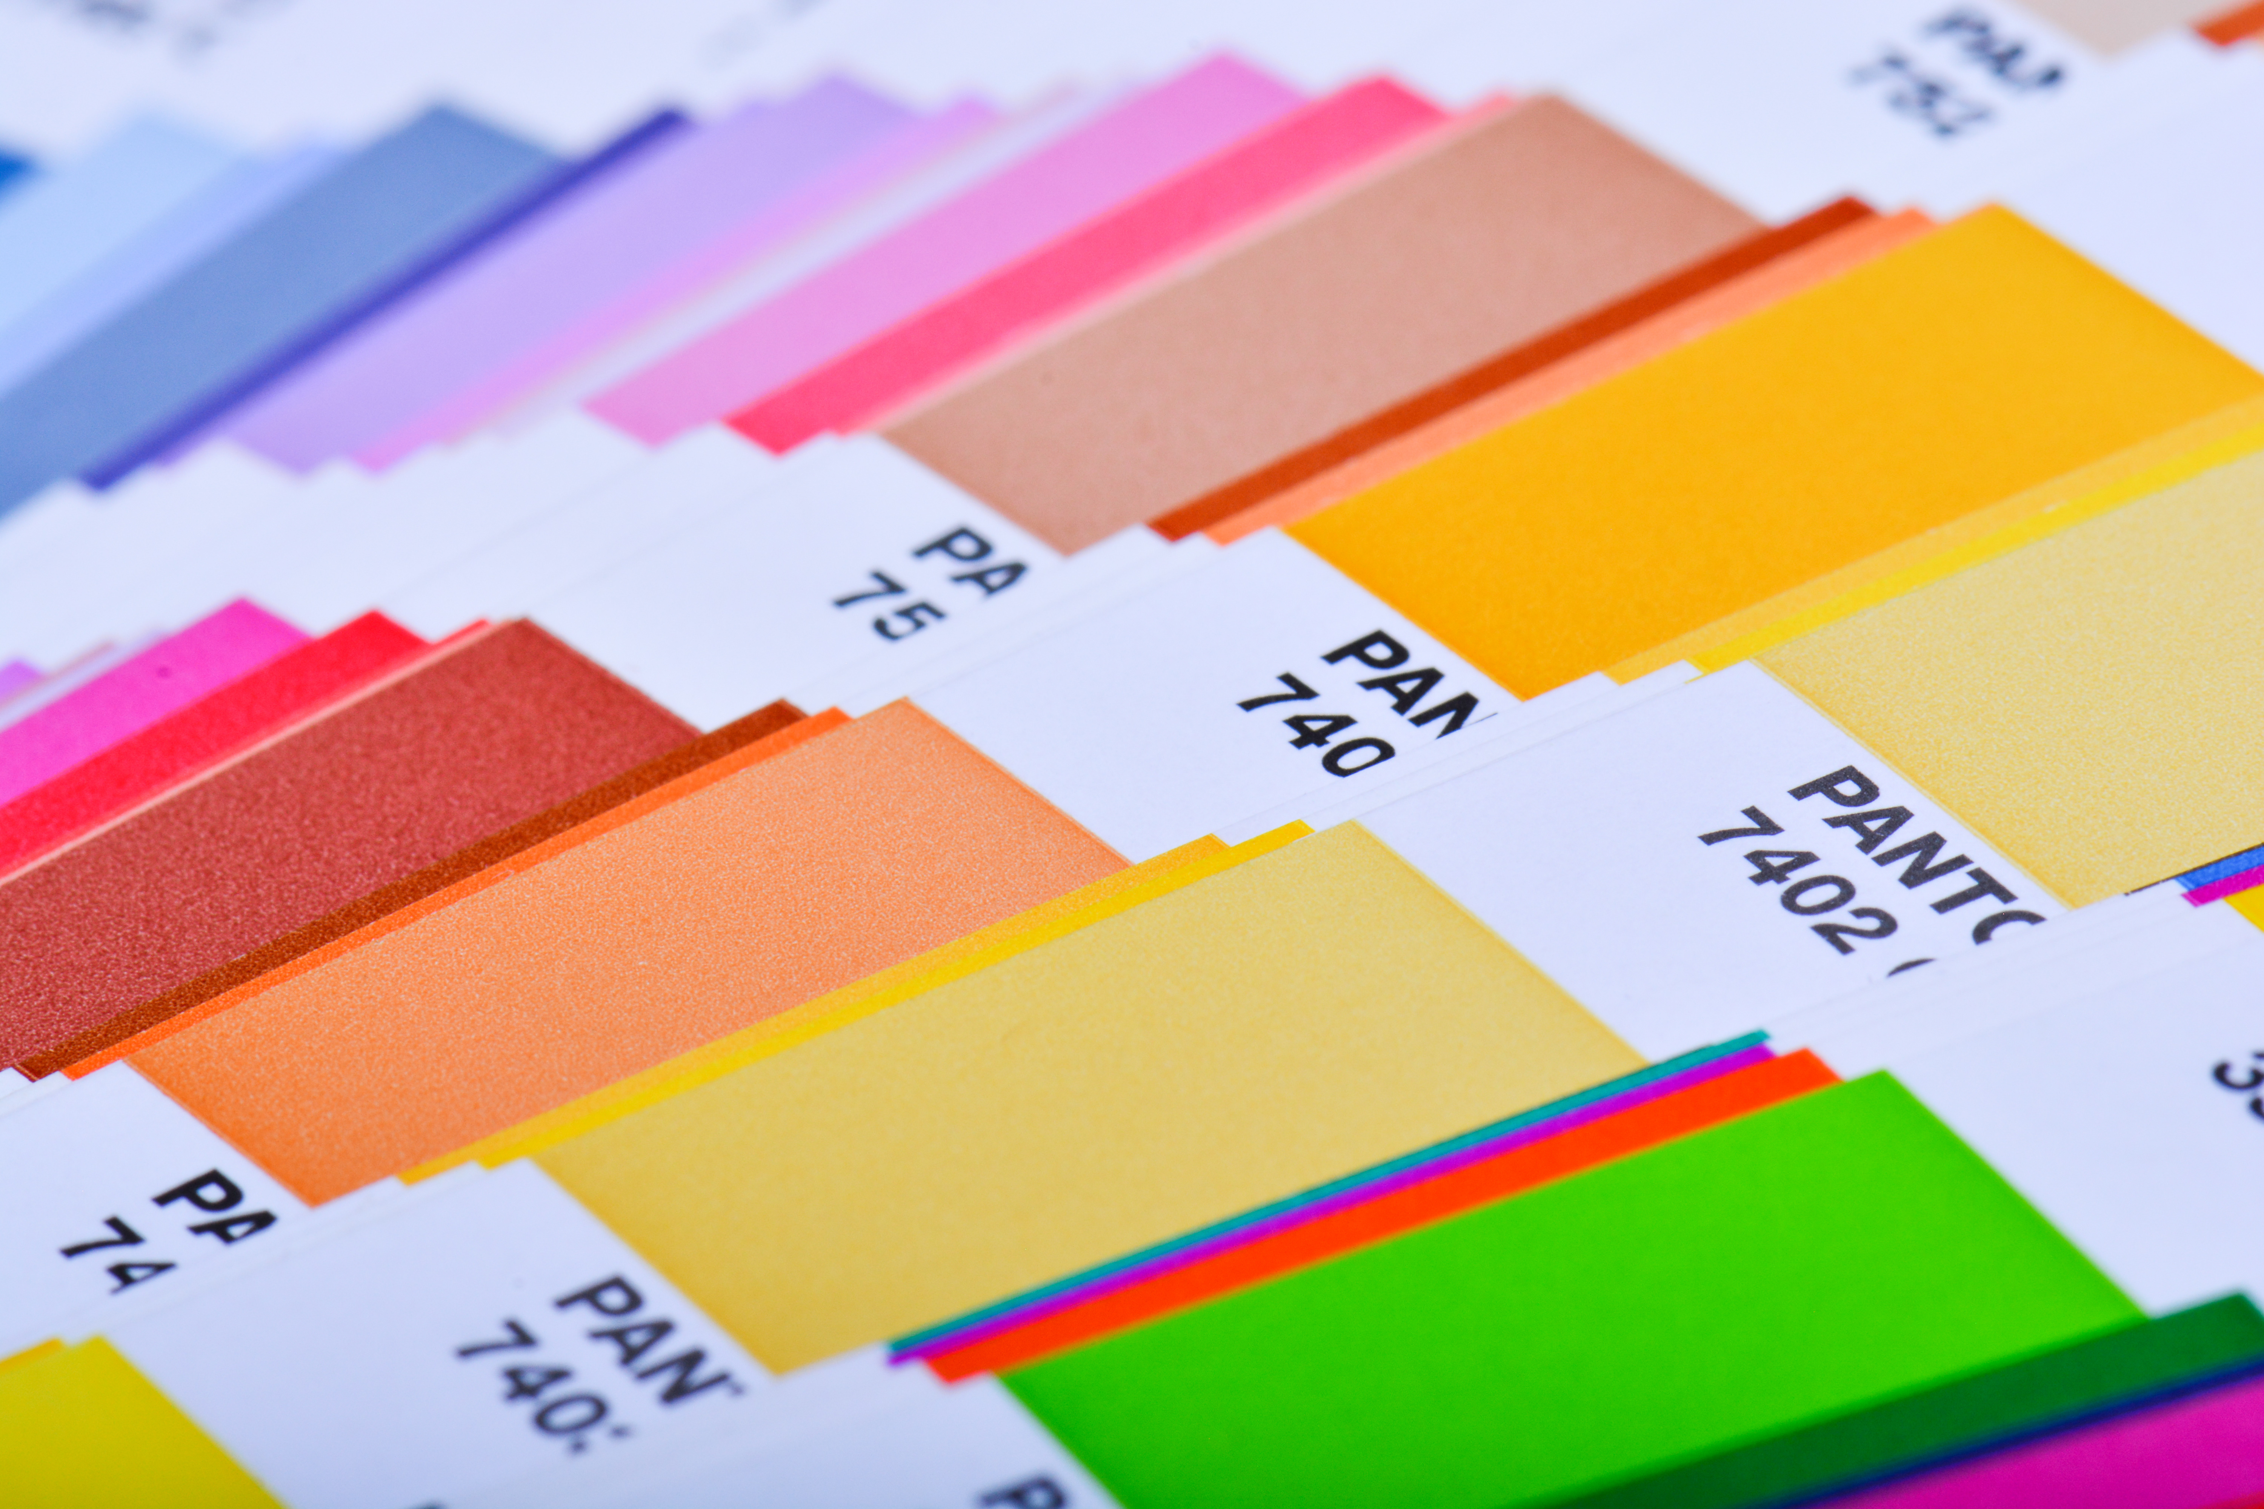
3 Ways to Beautify Your Web Parts
Theme Enabled
Leverage UI Fabric React
Leverage SPFx UI Fabric Themes

Slide 37
Demo
Theme Enabled Web Part

Slide 38
Demo
UI Fabric React

Slide 39
Agenda
What is the UI Fabric?
Adding UI Fabric to Web Parts
Responsive Design
Creating a UI Fabric Web Part
How to Use React Components
Q&A

Slide 40
Demo
SPFx UI Fabric Themes

Slide 41

Recap
Notes:
Tips and tricks

Slide 42
Recap
Learned what the UI Fabric is and how we can add it to our web parts
Notes:
Tips and tricks

Slide 43
Recap
Learned what the UI Fabric is and how we can add it to our web parts
Talked about responsive design and accessibility
Notes:
Tips and tricks

Slide 44
Recap
Learned what the UI Fabric is and how we can add it to our web parts
Talked about responsive design and accessibility
Looked at several ways to incorporate the UI Fabric into your web parts
Notes:
Tips and tricks

Slide 45
Recap
Learned what the UI Fabric is and how we can add it to our web parts
Talked about responsive design and accessibility
Looked at several ways to incorporate the UI Fabric into your web parts
Looked at examples of UI Fabric in action
Notes:
Tips and tricks

Slide 46
Recap
Learned what the UI Fabric is and how we can add it to our web parts
Talked about responsive design and accessibility
Looked at several ways to incorporate the UI Fabric into your web parts
Looked at examples of UI Fabric in action
Talked about the importance of branding on the user experience

Slide 47
Time for Q&A…

Slide 48
Resources
UI Fabric Site - https://developer.microsoft.com/en-us/fabric#/
UI Fabric Icons - https://uifabricicons.azurewebsites.net/
SPFx-uifabric-themes - https://github.com/n8design/spfx-uifabric-themes
Responsive Design Guidelines – https://www.w3schools.com/html/html_responsive.asp
Web Accessibility Guidelines - https://www.w3.org/WAI/standards-guidelines/wcag/
The Code - https://github.com/dcashpeterson/Public-Samples

Slide 49

THANK YOU!

